Slide 1

PYTHON PROGRAMMING UNIT IV
Department of Computer Science and Engineering,
School of Computing
SATHYABAMA
Institute of Science and Technology
Deemed to be University
Chennai.

Slide 2
UNIT-IV DATABASE (using NoSQL)

Slide 3
Syllabus
Introduction
MongoDB
Connector Module
Cursor Statements
Exceptions in database
Network Connectivity
Socket module
Client
Server
Email
URL Access

Slide 4
Introduction
A database represents a collection of data
operations :
modifying the existing data
deleting the unwanted data
retrieving the data from the database

Slide 5
DBMS
To perform such operations, a database comes with software. This is called a database management system.
DBMS= Database + Software to manage the data
Example :
MySQL, Oracle, Sybase, SQL server etc.

Slide 6
Database Software
SQL (Structured Query Language)
NoSQL (Not Only SQL)
When do we use NoSQL:
Data in forms like key-value, document, columnar, and graph.
When working with large sets of distributed data.
applications involving BIG DATA

Slide 7
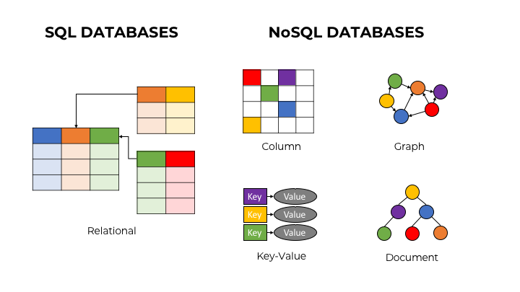
Database Types with NoSQL

Slide 8
MongoDB
MongoDB stores data in JSON-like documents, which makes the database very flexible and scalable.
Where to Use MongoDB?
Big Data
Content Management and Delivery
Mobile and Social Infrastructure
User Data Management
Data Hub
download a free MongoDB database at https://www.mongodb.com

Slide 9
Package and Methods Used
Package:
pymongo
Methods:
MongoClient()

Slide 10
Python MongoDB
To create a database in MongoDB
start by creating a MongoClient object,
then specify a connection URL with the correct ip address
and the name of the database you want to create.
CODE
import pymongo myclient =pymongo.MongoClient("mongodb://localhost:27017/") mydb = myclient["mydatabase"] #database created!

Slide 11
Python MongoDB
Check if Database Exists
list_database_names())
CODE
dblist = myclient.list_database_names() print(myclient.list_database_names())
if "mydatabase" in dblist: print("The database exists.")
Output
[‘mydatabase’]
The database exists.

Slide 12
Python MongoDB Insert Document
To insert a record, or document as it is called in MongoDB, into a collection,
insert_one()
Insert Multiple Documents To insert multiple documents into a collection.
insert_many()
The first parameter of the insert_many() method is a list containing dictionaries with the data you want to insert:

Slide 13
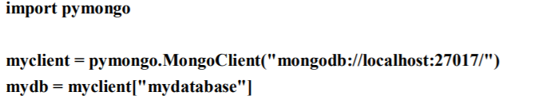
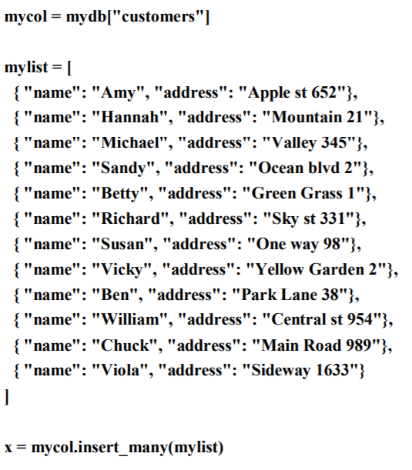
Example – to insert

Slide 14
Python MongoDB - Find
find_one() - methods to find data in a collection.
Just like the SELECT statement is used to find data in a table in a MySQL database.
find_one()
The find_one() method returns the first occurrence in the selection.

Slide 15
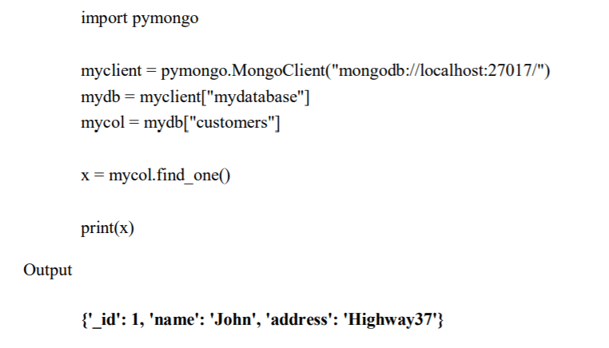
Example -find

Slide 16
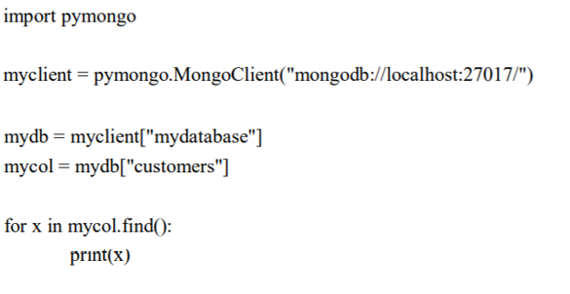
Find All
To select data from a table in MongoDB,
find()
The find() method returns all occurrences in the selection.

Slide 17
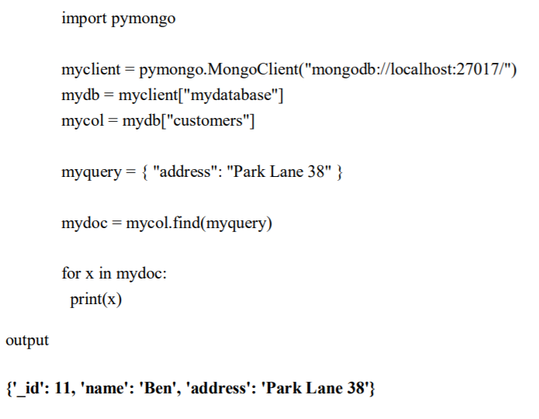
Filter the Result
When finding documents in a collection, you can filter the result by using a query object.
Example:
Find document(s) with the address "Park Lane 38":

Slide 18
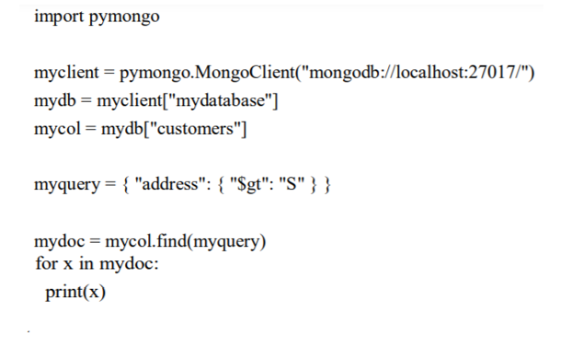
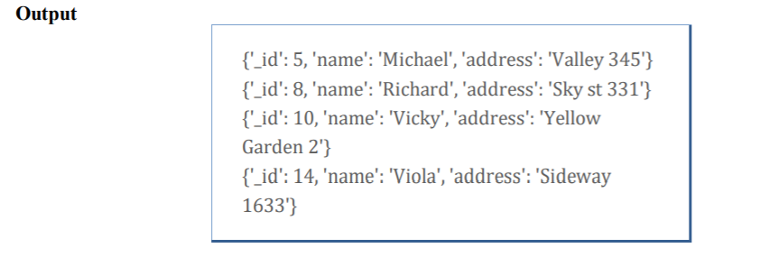
Example
Find documents where the address starts with the letter "S" or higher:

Slide 19
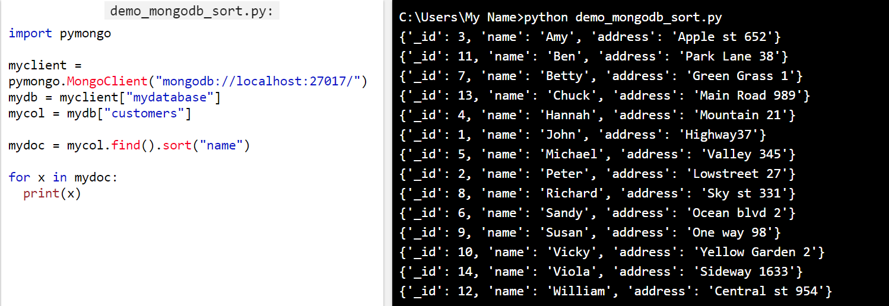
Sort the Result
Use the sort() method to sort the result in ascending or descending order.

Slide 20

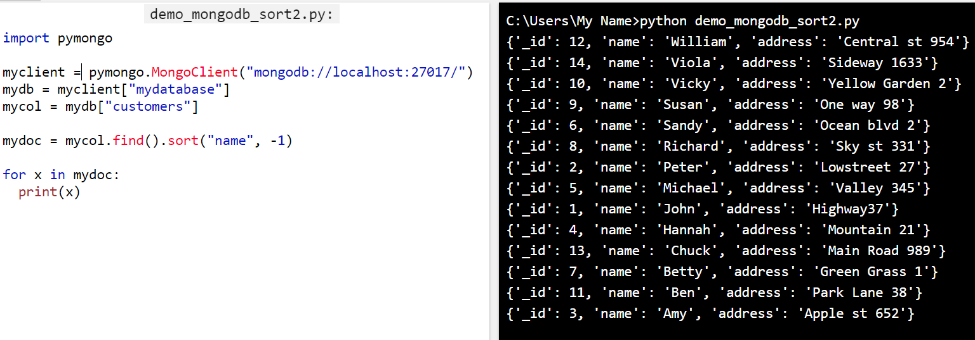
Sort Descending
Use the value -1 as the second parameter to sort descending.

Slide 21
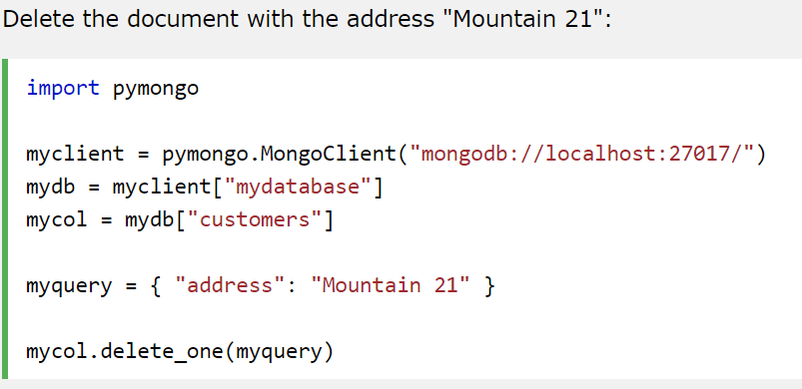
Delete Document
To delete one document
Delete_one()

Slide 22
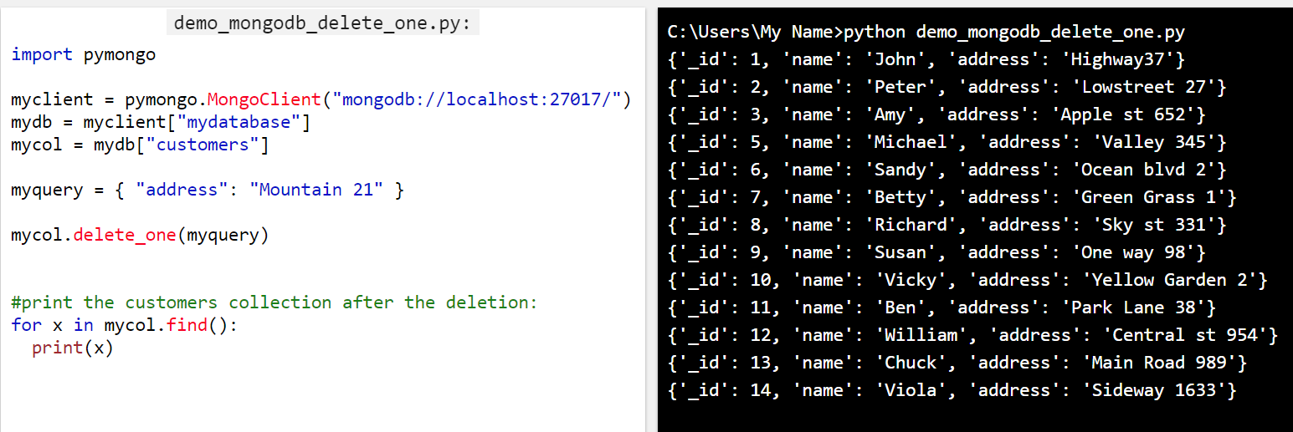
Example

Slide 23
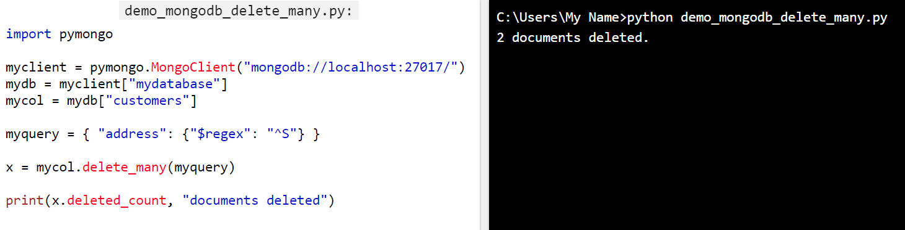
Delete Many Documents
delete_many()
Example: Delete all documents were the address starts with the letter S

Slide 24
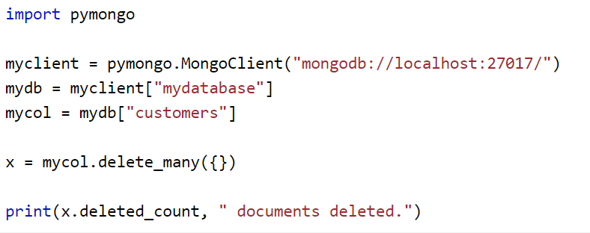
Delete All Documents in a Collection

Slide 25
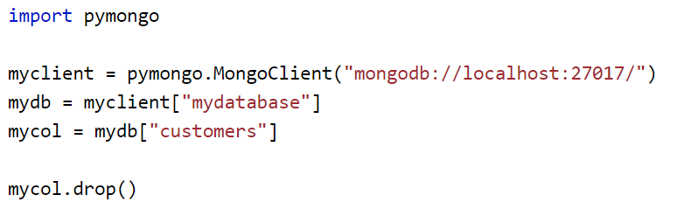
Drop Collection
Delete Collection – drop() method
Example:Delete the "customers" collection:
The drop() method returns true if it the collection dropped, otherwise returns false.

Slide 26
Update Collection
To update a record, or document as it is called in MongoDB:
update_one(myquery, newvalues)
Myquery – the document to be updated, if it finds more than one record, only the first occurrence is updated.
Newvalues –object defining the new values of the document.

Slide 27
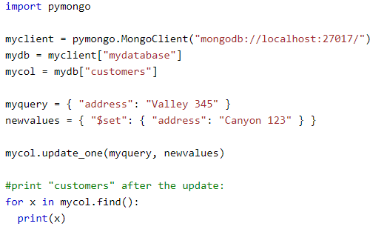
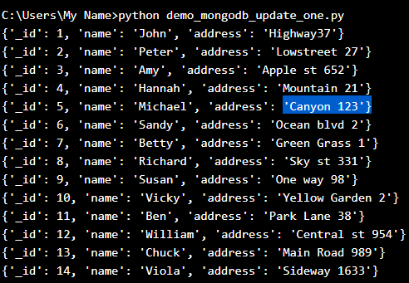
Example: Change the address from "Valley 345" to "Canyon 123":

Slide 28
Update Many
To update all documents that meets the criteria of the query
update_many()

Slide 29
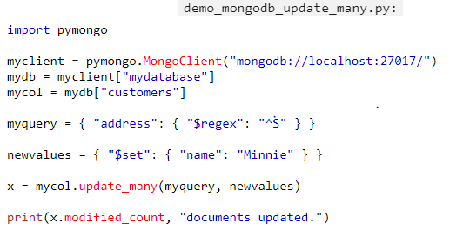

Example:Update all documents where the address starts with the letter "S":

Slide 30
Limit the Result
To limit the result in MongoDB
limit()
Example: limit(5)

Slide 31
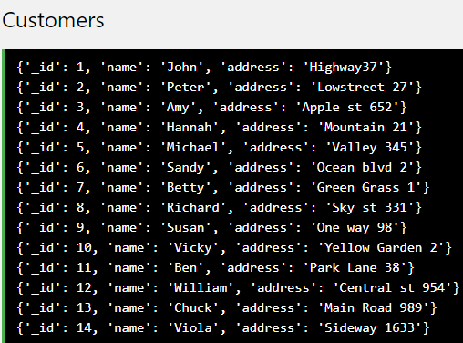
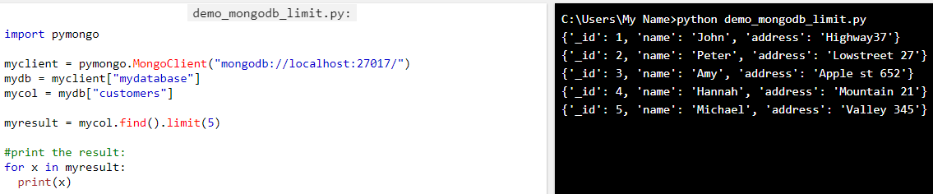
Example Limit the result to only return 5 documents:

Slide 32
Connector Module
To work with MySQL in python, connector sub module of mysql module is used.
import mysql.connector;
to establish connection with MySQL database,
connect() method of mysql.connector module as:
conn=mysql.connector.connect(host=’localhost’,
database=’university’,
user=’root’,
password=’***’)
Username – i.e., the username that you use to work with MySQL Server. The default username for the MySQL database is a root
Password – Password is given by the user at the time of installing the MySQL database. If you are using root then you won’t need the password.
Host Name – is the server name or Ip address on which MySQL is running. if you are running on localhost, then you can use localhost, or it’s IP, i.e. 127.0.0.0
Database Name – Database name to which you want to connect. Here we are using Database named ‘Electronics‘ because we have already created this for our example.

Slide 33
Steps to connect MySQL database in Python using MySQL Connector Python
Install MySQL Connector Python using pip.
Use the mysql.connector.connect() method of MySQL Connector Python with required parameters to connect MySQL.
Use the connection object returned by a connect() method to create a cursor object to perform Database Operations.
The cursor.execute() to execute SQL queries from Python.
Close the Cursor object using a cursor.close() and MySQL database connection using connection.close() after your work completes.
Catch Exception if any that may occur during this process.

Slide 34
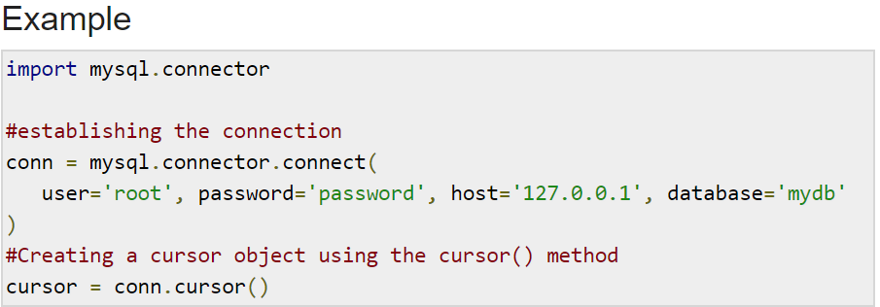
Cursor Class
Create Cursor object using the cursor() method of the Connection object/class.

Slide 35
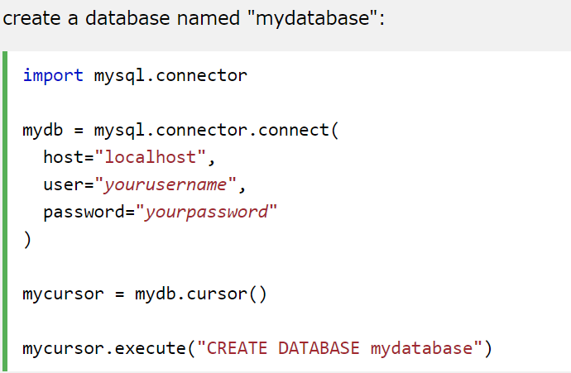
Create a DB

Slide 36
Exceptions in DB
Interacting with a database is an error prone process, so we must always implement some mechanism to handle errors.

Slide 37
Network Programming
For a specific purpose if things are connected together, are referred as a NETWORK.
A network can be of many types, like a telephone network, television network, computer network or even a people network.
A COMPUTER NETWORK is also a kind of setup, where it connects two or more devices.
Interconnection of computers is called a network.
To share a range of services and information in the form of e-mails and messages, databases, documents, web-sites, audios and video’s, Telephone calls and video conferences etc.

Slide 38
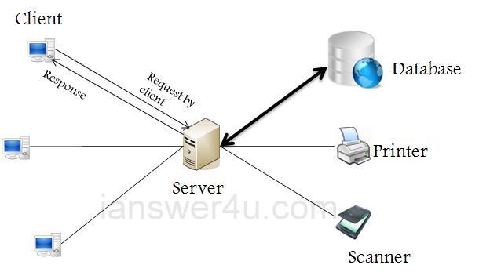
Client & Server

Slide 39
Network Requirements
Hardware: Includes the Computers, cables,modems,routers, hubs etc.
Software: Includes programs to communicate between servers and clients.
Protocols: Represents a way to establish connection and helps in sending and receiving data in a standard format.

Slide 40
Protocol
A set of rules to be followed by every computer on the network.
Use: Physically move data from one place to another place on a network.
Some basic Protocols are:
IP : Internet Protocol
FTP : File Transfer Protocol
SMTP : Simple Mail Transfer Protocol
HTTP : Hyper Text Transfer Protocol

Slide 41
What Are Sockets?
To establish a logical connecting point between a server and a client , the communication can be done through that point.
This point is called socket.
Basically, sockets act as a communication link between two entities, i.e. a server and a client.
A server will give out information being requested by a client.
For example, when you visited this page, the browser created a socket and connected to the server.

Slide 42
The socket Module
In order to create a socket,
socket.socket() function,
syntax:
import socket
s= socket.socket (socket_family, socket_type, protocol=0)
Arguments:
socket_family: Represents the address (and protocol) family. It can be either AF_UNIX or AF_INET.
socket_type: Represents the socket type, and can be either SOCK_STREAM or SOCK_DGRAM.
protocol: This is an optional argument, and it usually defaults to 0.
Notes:
Family- internet protocol IPV4-
INET6
Socket-stream # for TCP protocol
For UDP protool

Slide 43
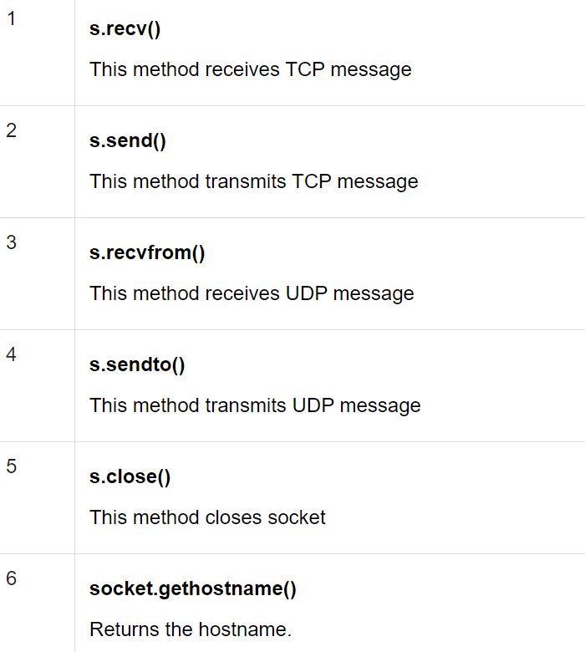
Method of Socket Module
Notes:
After obtaining your socket object,
create a server or client as desired using the methods available in the socket module.

Slide 44
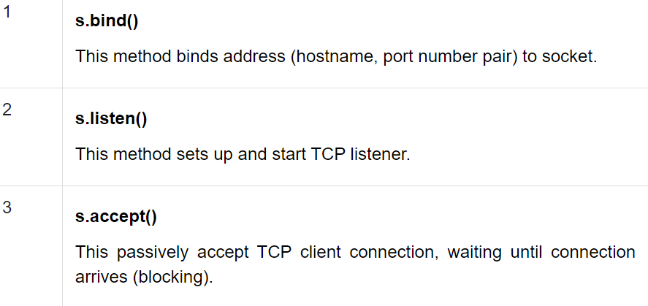
Server Socket Methods

Slide 45
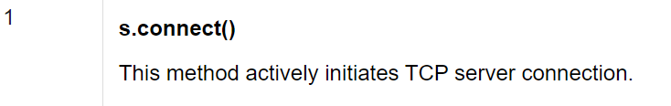
Client Socket Method
Syntax:
socket.connect(hostname, port )

Slide 46
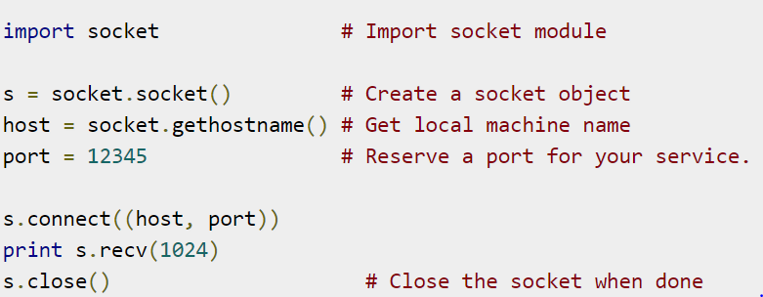
Create a Simple Client

Slide 47
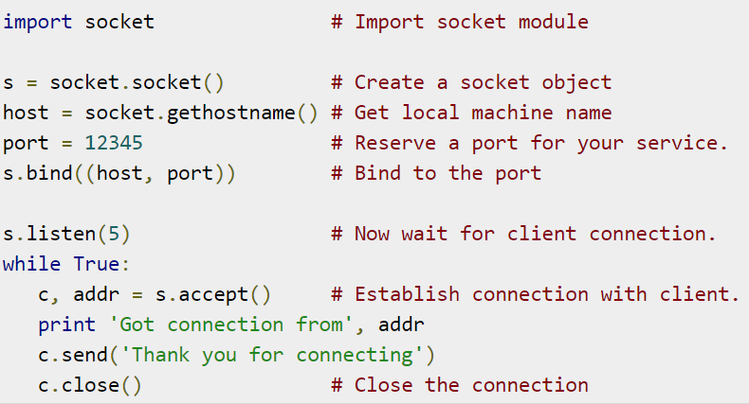
Create a Simple Server

Slide 48
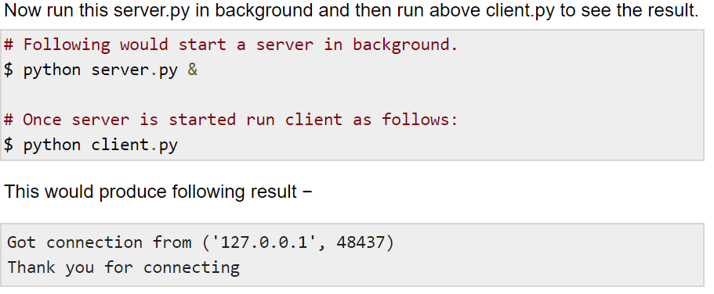
OUTPUT

Slide 49
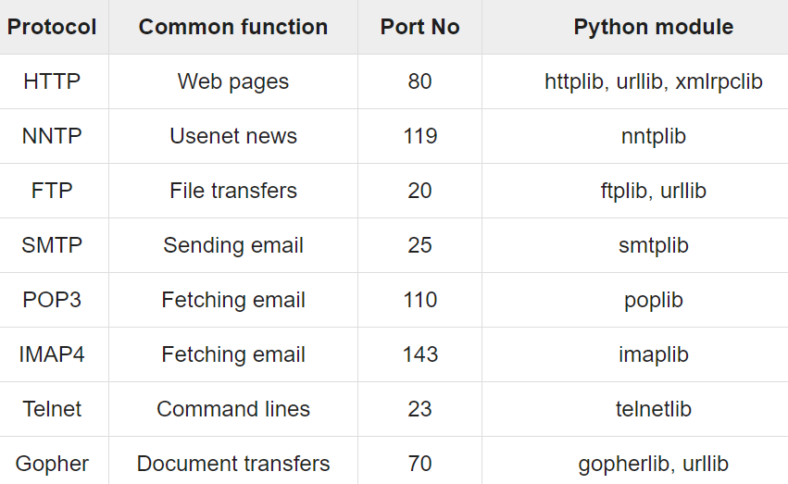
Python Internet Modules

Slide 50
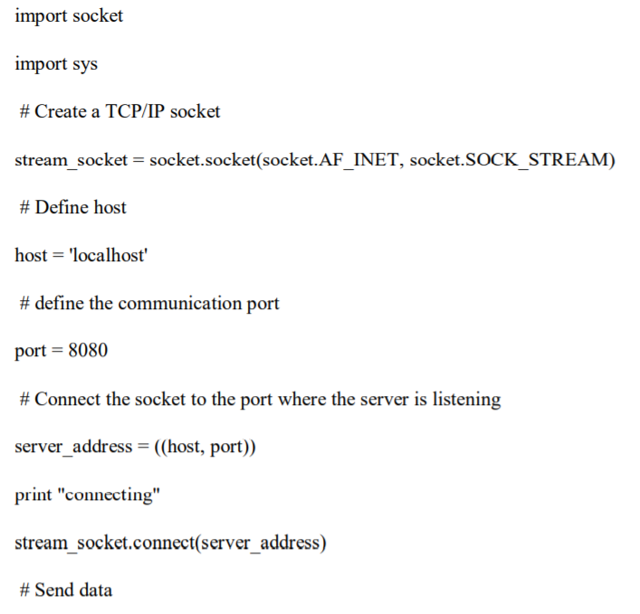
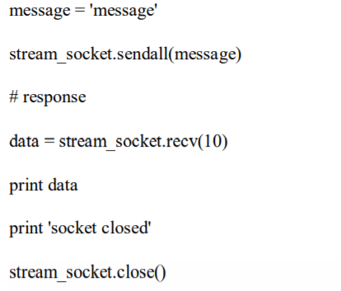
Example: Client

Slide 51
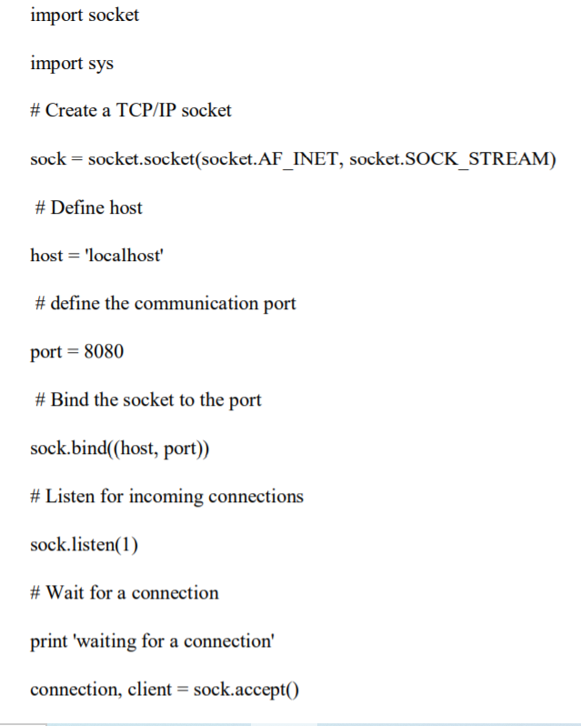
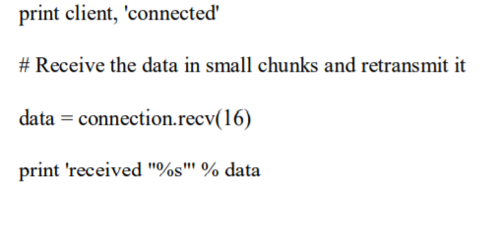
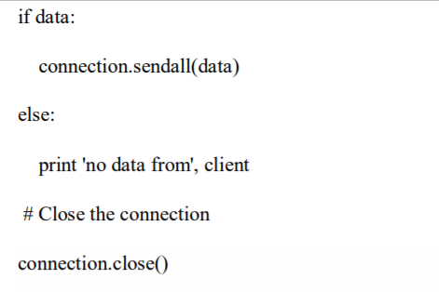
Example: Server

Slide 52
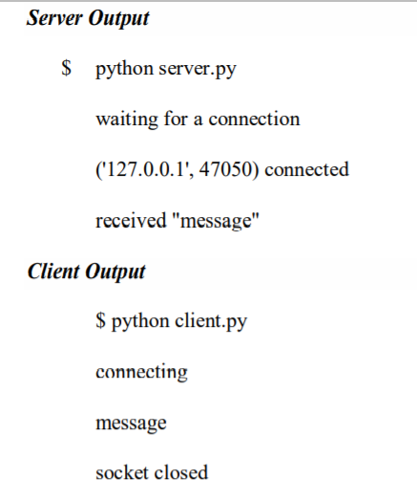
Output

Slide 53
Socket Methods
bind(host,port)
Host- name of an IP address or a website name
Port
listen(no.of connections allowed)
accept() – server should wait tilla client accepts connection.
c,addr=s.accept()
c-> connection object can be used to send messages
addr-> address of the client that has accepted the connection
Notes:
No network- localhost -127.0.0.1

Slide 54
Socket Methods
Send()– to send message strings to client. Message string should be sent in the form of byte streams as they are used by TCP/IP protocol.
recv(1024) – to receive message from the server. Here 1024 is the buffer size. - -Memory used while receiving the data.
-At a time 1024 byes of data can be received from server.
-This limit can be changed in multiples of 1024.

Slide 55
Socket Methods
sendto()- server send the data in the form of packets called “datagrams”. Since UDP is connection- less protocol, server does not know where the data should be sent .
Sendto(message,(host,port))
recvfrom() – client receive the message from server
mess,address=s.recvfrom(1024)
Mess-> the received message stored
Address -> address of the server

Slide 56
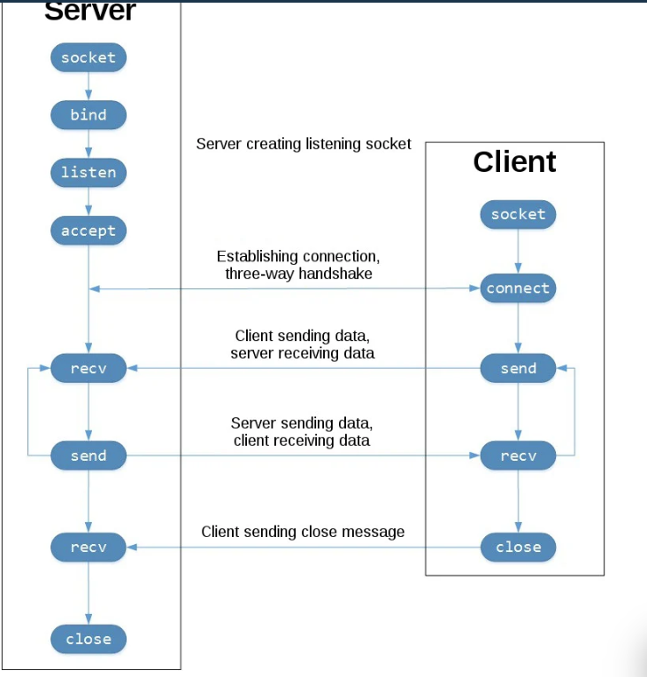
Client - Server Communication

Slide 57
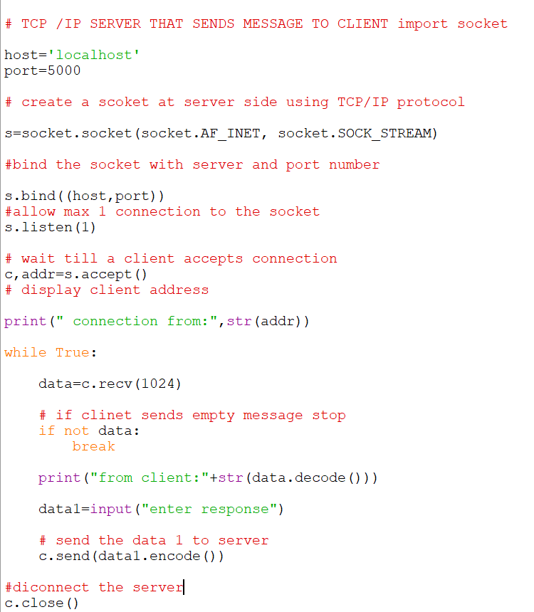
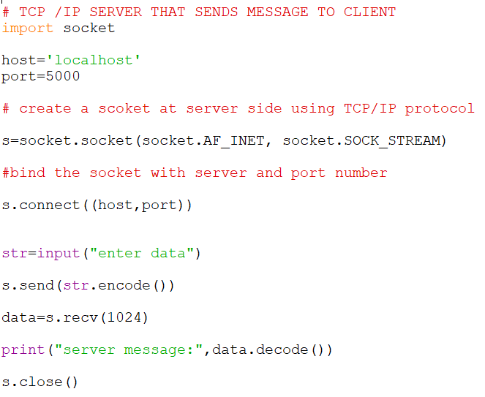
Two way Communication between Client and Server (Chat Application)

Slide 58
Sending a Simple Mail
To develop program to a mail to any email address.
Use SMTP – protocol.( Simple Mail Transfer Protocol)
Module used- smtplib
To connect to gmail server
Server=smtplib.SMPT(“smtp.gmail.com”,587)
To connect with gmail server the port no- 587
Once connected to mail server, we can send the mail
Server.send_message(msg)
Msg- covers the total message includes- from and to address,subject,mail content

Slide 59
MIMEText class
Message is represented as an object of MIMEText class.
It belongs to email.mime.text module
MIME( Multi-purpose Internet Mail Extensions).
MIME indicates an extension of the original Internet email protocol that lets people use the protocol to exchange different kinds of data on the internet .
Msg=MIMEText(body)
Msg[‘From’]=fromaddress
Msg[‘To’]=toaddress
Msg[‘subject’]=“Subject line “

Slide 60
Steps:To Login into Server with a valid password
Create SMTP connection into TLS(Transport Layer Security) mode.
This will start the process of verifying authenticity of the sender.
Server.starttls()
2. Login to the server with our email address and pass word.
server.login(fromaddress,”password”)

Slide 61
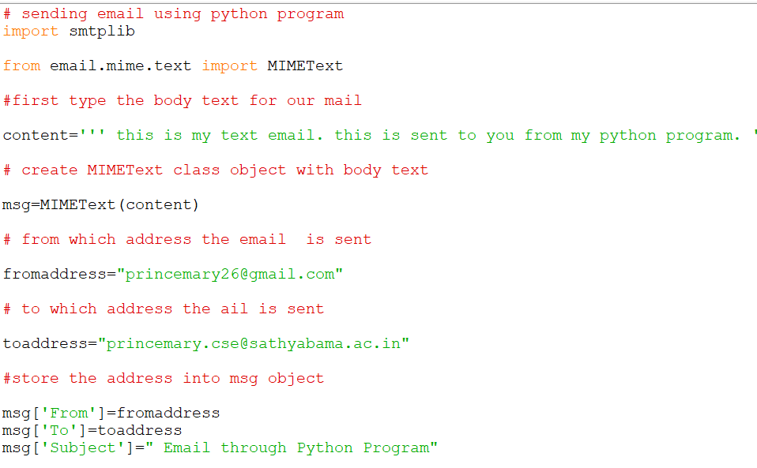
Example

Slide 62
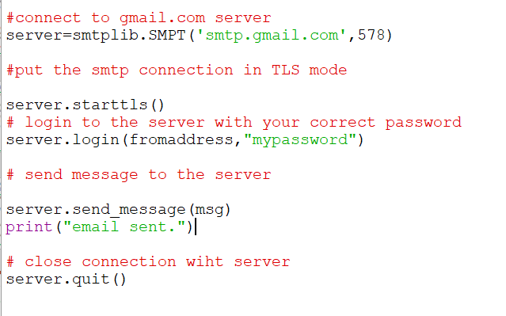

Slide 63
URL Address
Uniform Resource Locator represents te address that is specified to access some information or resources on internet.
Example: http://www.dreamtechpress.com:80/index.html
The URL contains 4 parts:
The Protocol to use (http://)
The server name or the IP address of the server
Port number, optional (:80)
File that is referred. (index/home.html)

Slide 64
URL Module
urllibparse-module
tpl=urllib.parse(“urlstring”) or geturl()
Retrieve the each part of the URL from the tuple
Scheme = protocol name in the URL
Netloc= website name
Path= path of the web page
Port= port number

Slide 65
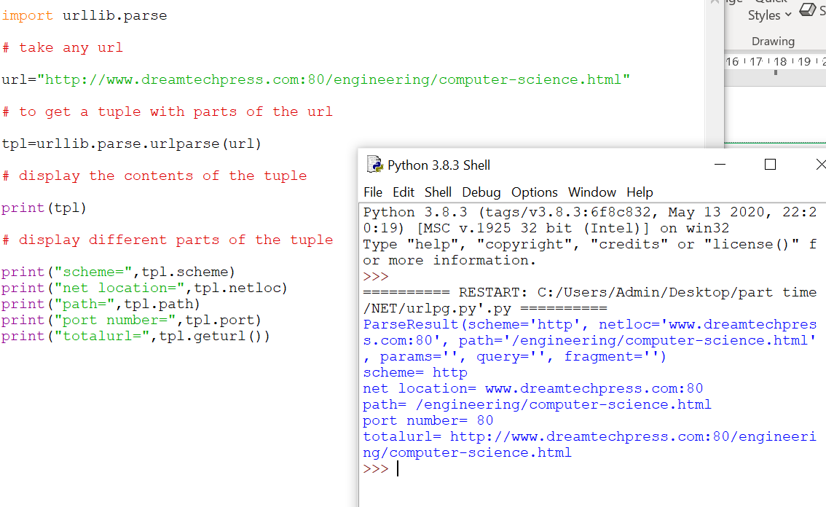
Example

